Slide 1
Abstract Data Structures
TOPIC 5.0 – ABSTRACT DATA STRUCTURES
TOPIC 5
Queues and Usage of Stacks and Queues

Slide 2

REVIEW REVIEW REVIEW REVIEW REVIEW REVIEW
THE WARM-UP QUESTION
Write a Python script that will push at least three numbers to a stack, then add them all together by popping them

Slide 3
REVIEW REVIEW REVIEW REVIEW REVIEW REVIEW
THE WARM-UP ANSWER
stack = []
stack.append(15)
stack.append(25)
stack.append(35)
print(stack.pop() + stack.pop() + stack.pop())

Slide 4
Topic 5.1.8 – ABSTRACT DATA STRUCTURES
Queues
Last time, we discussed Stacks
Stacks are an abstract data type that is LIFO
The last item added is the first item that gets removed
Today, we’ll be discussing the stack’s counterpart – the Queue
The queue is FIFO
The first item added is the first item that gets removed

Slide 5

Topic 5.1.8 – ABSTRACT DATA STRUCTURES
Queues
Think of this like a line at a restaurant
The first person to get their order taken (removed from the line) is the person who got in line first
Assuming that no people swapped places, the filthy cutters
Queue

Slide 6
Topic 5.1.8 – ABSTRACT DATA STRUCTURES
Queue Methods
enqueue()
Adds an item to the end of a queue
dequeue()
Removes the item from the front of the queue
isEmpty()
Returns true if the queue is empty, false otherwise

Slide 7
Topic 5.1.9 – ABSTRACT DATA STRUCTURES
Queue Methods
enqueue()
.append() in Python
Adds an item to the end of a queue
dequeue()
.pop(0) in Python
Removes the item from the front of the queue
isEmpty()
Returns true if the queue is empty, false otherwise

Slide 8
Topic 5.1.9 – ABSTRACT DATA STRUCTURES
OH, PYHTON
Python, once again, in its infinite simplicity also lacks a built-in queue
Python queues are again just lists with rules we impose on them
Here, we still use .append() to add items, just like the stack
Instead of doing .pop(), we will do .pop(0)
The 0 signifies that it is getting the first item from the queue, whereas pop with no number always gets the last item from a stack
Python users trying to implement a basic abstract data type

Slide 9
Topic 5.1.9 – ABSTRACT DATA STRUCTURES
Queue Methods
queue.enqueue(5)
queue.append(5)
Queue
5

Slide 10
Topic 5.1.9 – ABSTRACT DATA STRUCTURES
Queue Methods
queue.enqueue(3)
queue.append(3)
Queue
3
5

Slide 11
Topic 5.1.9 – ABSTRACT DATA STRUCTURES
Queue Methods
queue.dequeue()
queue.pop(0)
Queue
3

Slide 12
Topic 5.1.9 – ABSTRACT DATA STRUCTURES
Queue Methods
queue.enqueue(6)
queue.append(6)
queue.enqueue(10)
queue.append(10)
queue.enqueue(-12)
queue.append(-12)
queue.enqueue(3)
queue.append(3)
Queue
3
-12
10
6
3

Slide 13
Topic 5.1.9 – ABSTRACT DATA STRUCTURES
Queue Methods
output queue.dequeue() + queue.dequeue()
print queue.pop(0) + queue.pop(0)
This code will print 9
Queue
3
-12
10

Slide 14
Topic 5.1.8 – ABSTRACT DATA STRUCTURES
Queue Uses
Brainstorm some ways that you might interact with a programmed queue on a day to day basis

Slide 15
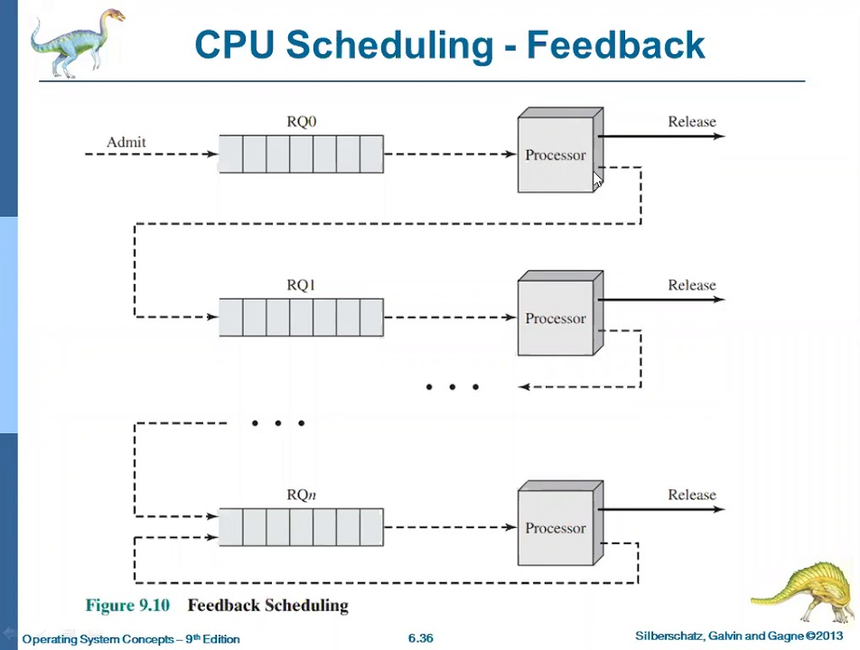
Topic 5.1.8 – ABSTRACT DATA STRUCTURES
Queue Uses
Your CPU decides which ‘process’ to run at any given moment using a much more complex version of a priority queue

Slide 16
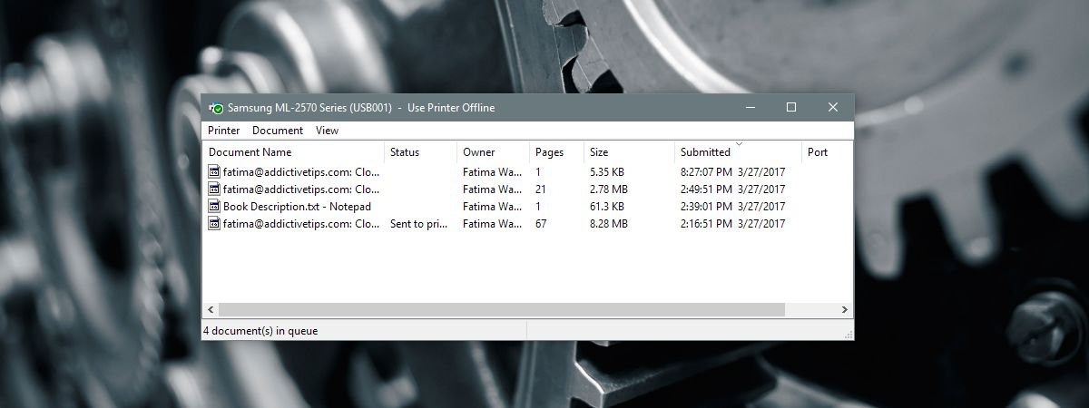
Topic 5.1.8 – ABSTRACT DATA STRUCTURES
Queue Uses
Printer queue for documents

Slide 17
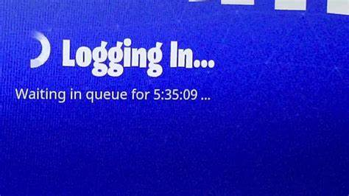
Topic 5.1.8 – ABSTRACT DATA STRUCTURES
Queue Uses
Anything simulating a real world object with a physical queue (maybe a diner-dash style game?)

Slide 18
Topic 5.1.8 – ABSTRACT DATA STRUCTURES
Queue Uses
Your CPU decides which ‘process’ to run at any given moment using a much more complex version of a priority queue
Printer queue for documents
Anything simulating a real world object with a physical queue (maybe a diner-dash style game?)

Slide 19
Topic 5.1.8 – ABSTRACT DATA STRUCTURES
Special queues
Priority Queues: Each item in the queue has a priority that decides which item gets popped off first
Circular Queues: Queue has a finite number of spaces, if the queue fills up it overwrites the first elements with new elements

Slide 20
Topic 5.1.8 – ABSTRACT DATA STRUCTURES
Queue In PSEUDOCODE
QUEUE = new Queue()
QUEUE.enqueue(“item”)
QUEUE.dequeue()
if QUEUE.isEmpty() then
…

Slide 21
Topic 5.1.8 – ABSTRACT DATA STRUCTURES
Queue In PYTHON
Again, queues don’t properly exist in Python
If you’d like to use a queue, adhere to using only .append(), .pop(0), and .isEmpty()

Slide 22

Topic 5.1 – THINKING RECURSIVELY
VOCAB TO REMEMBER
Queue
Enqueue
Dequeue

